Slide 1
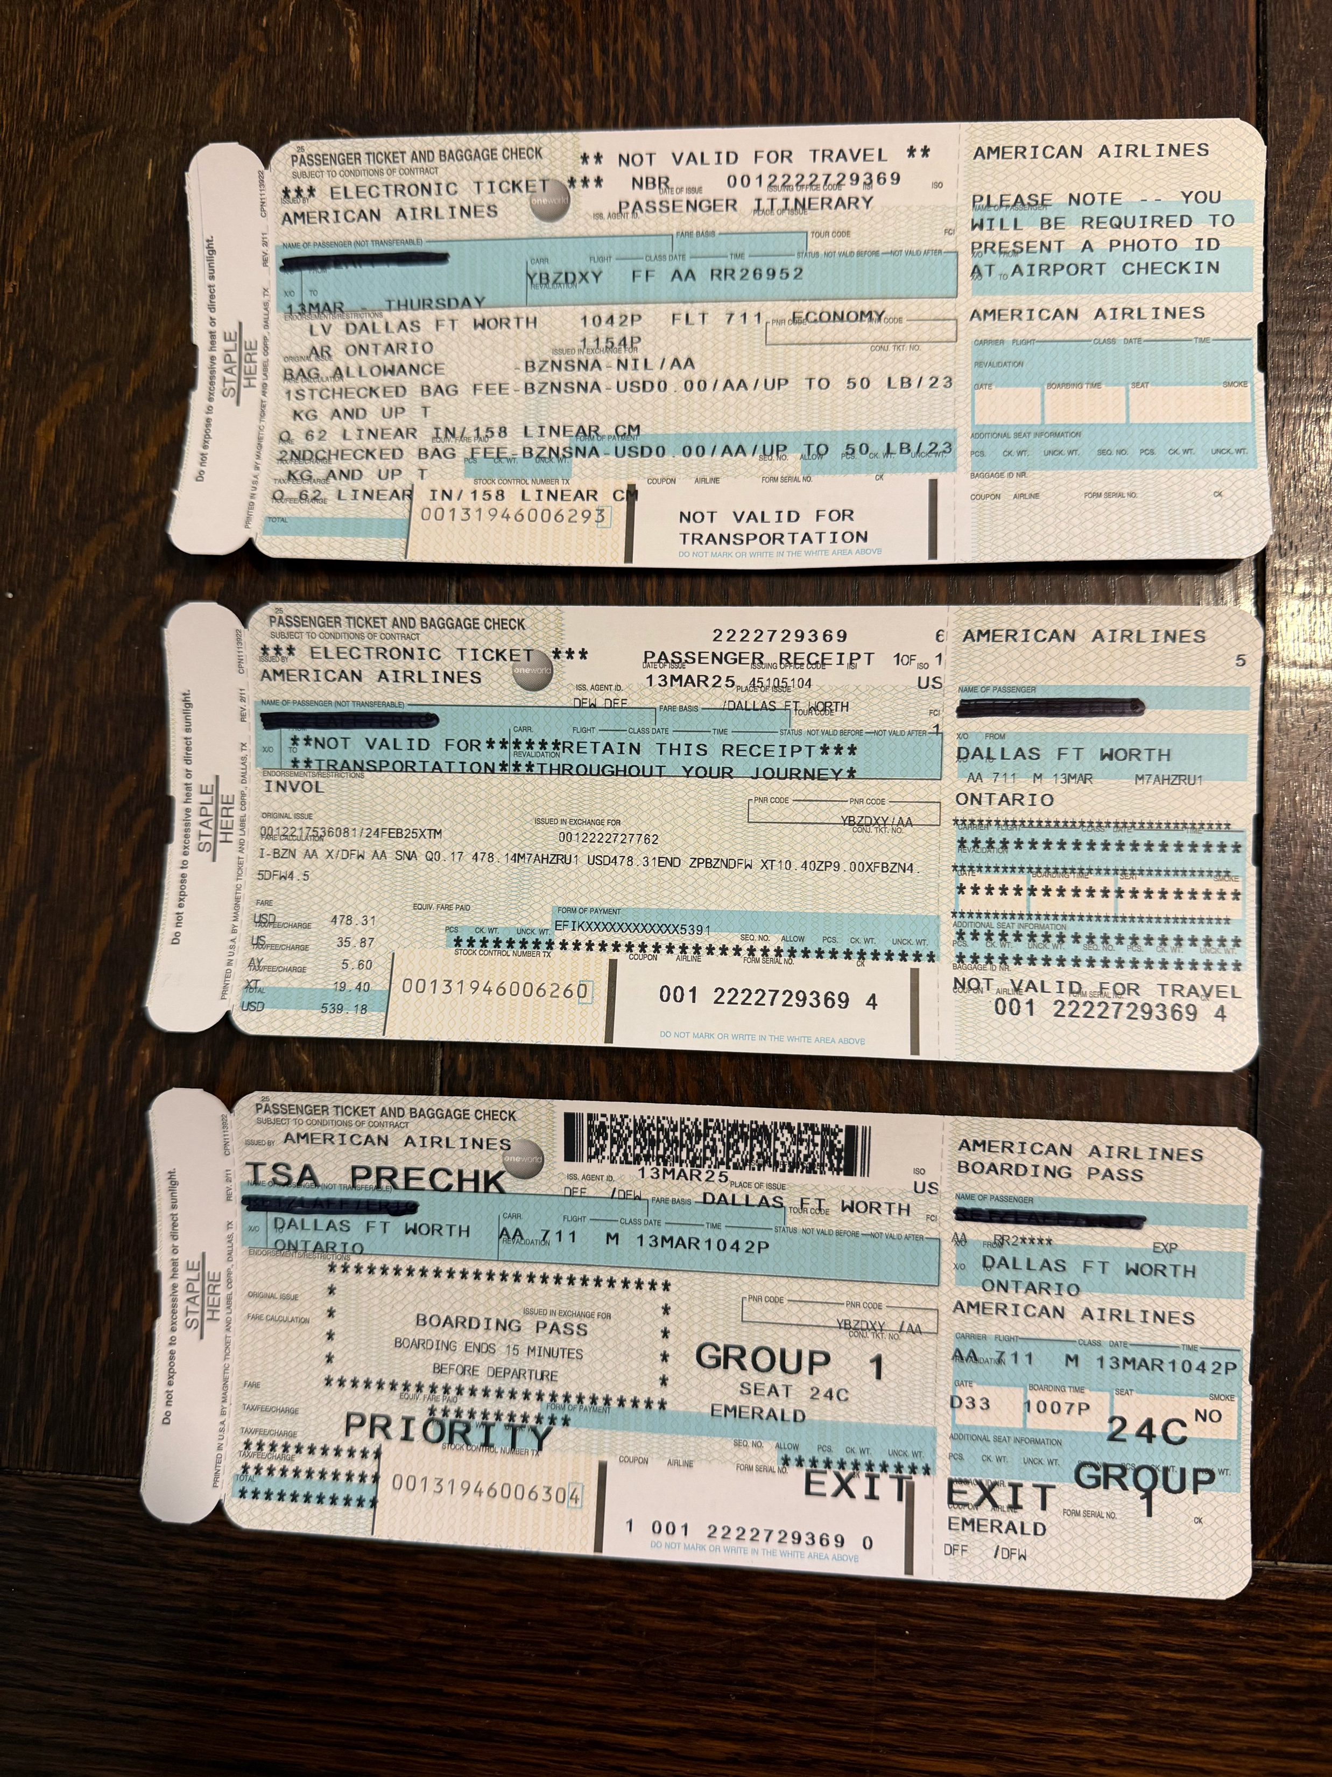
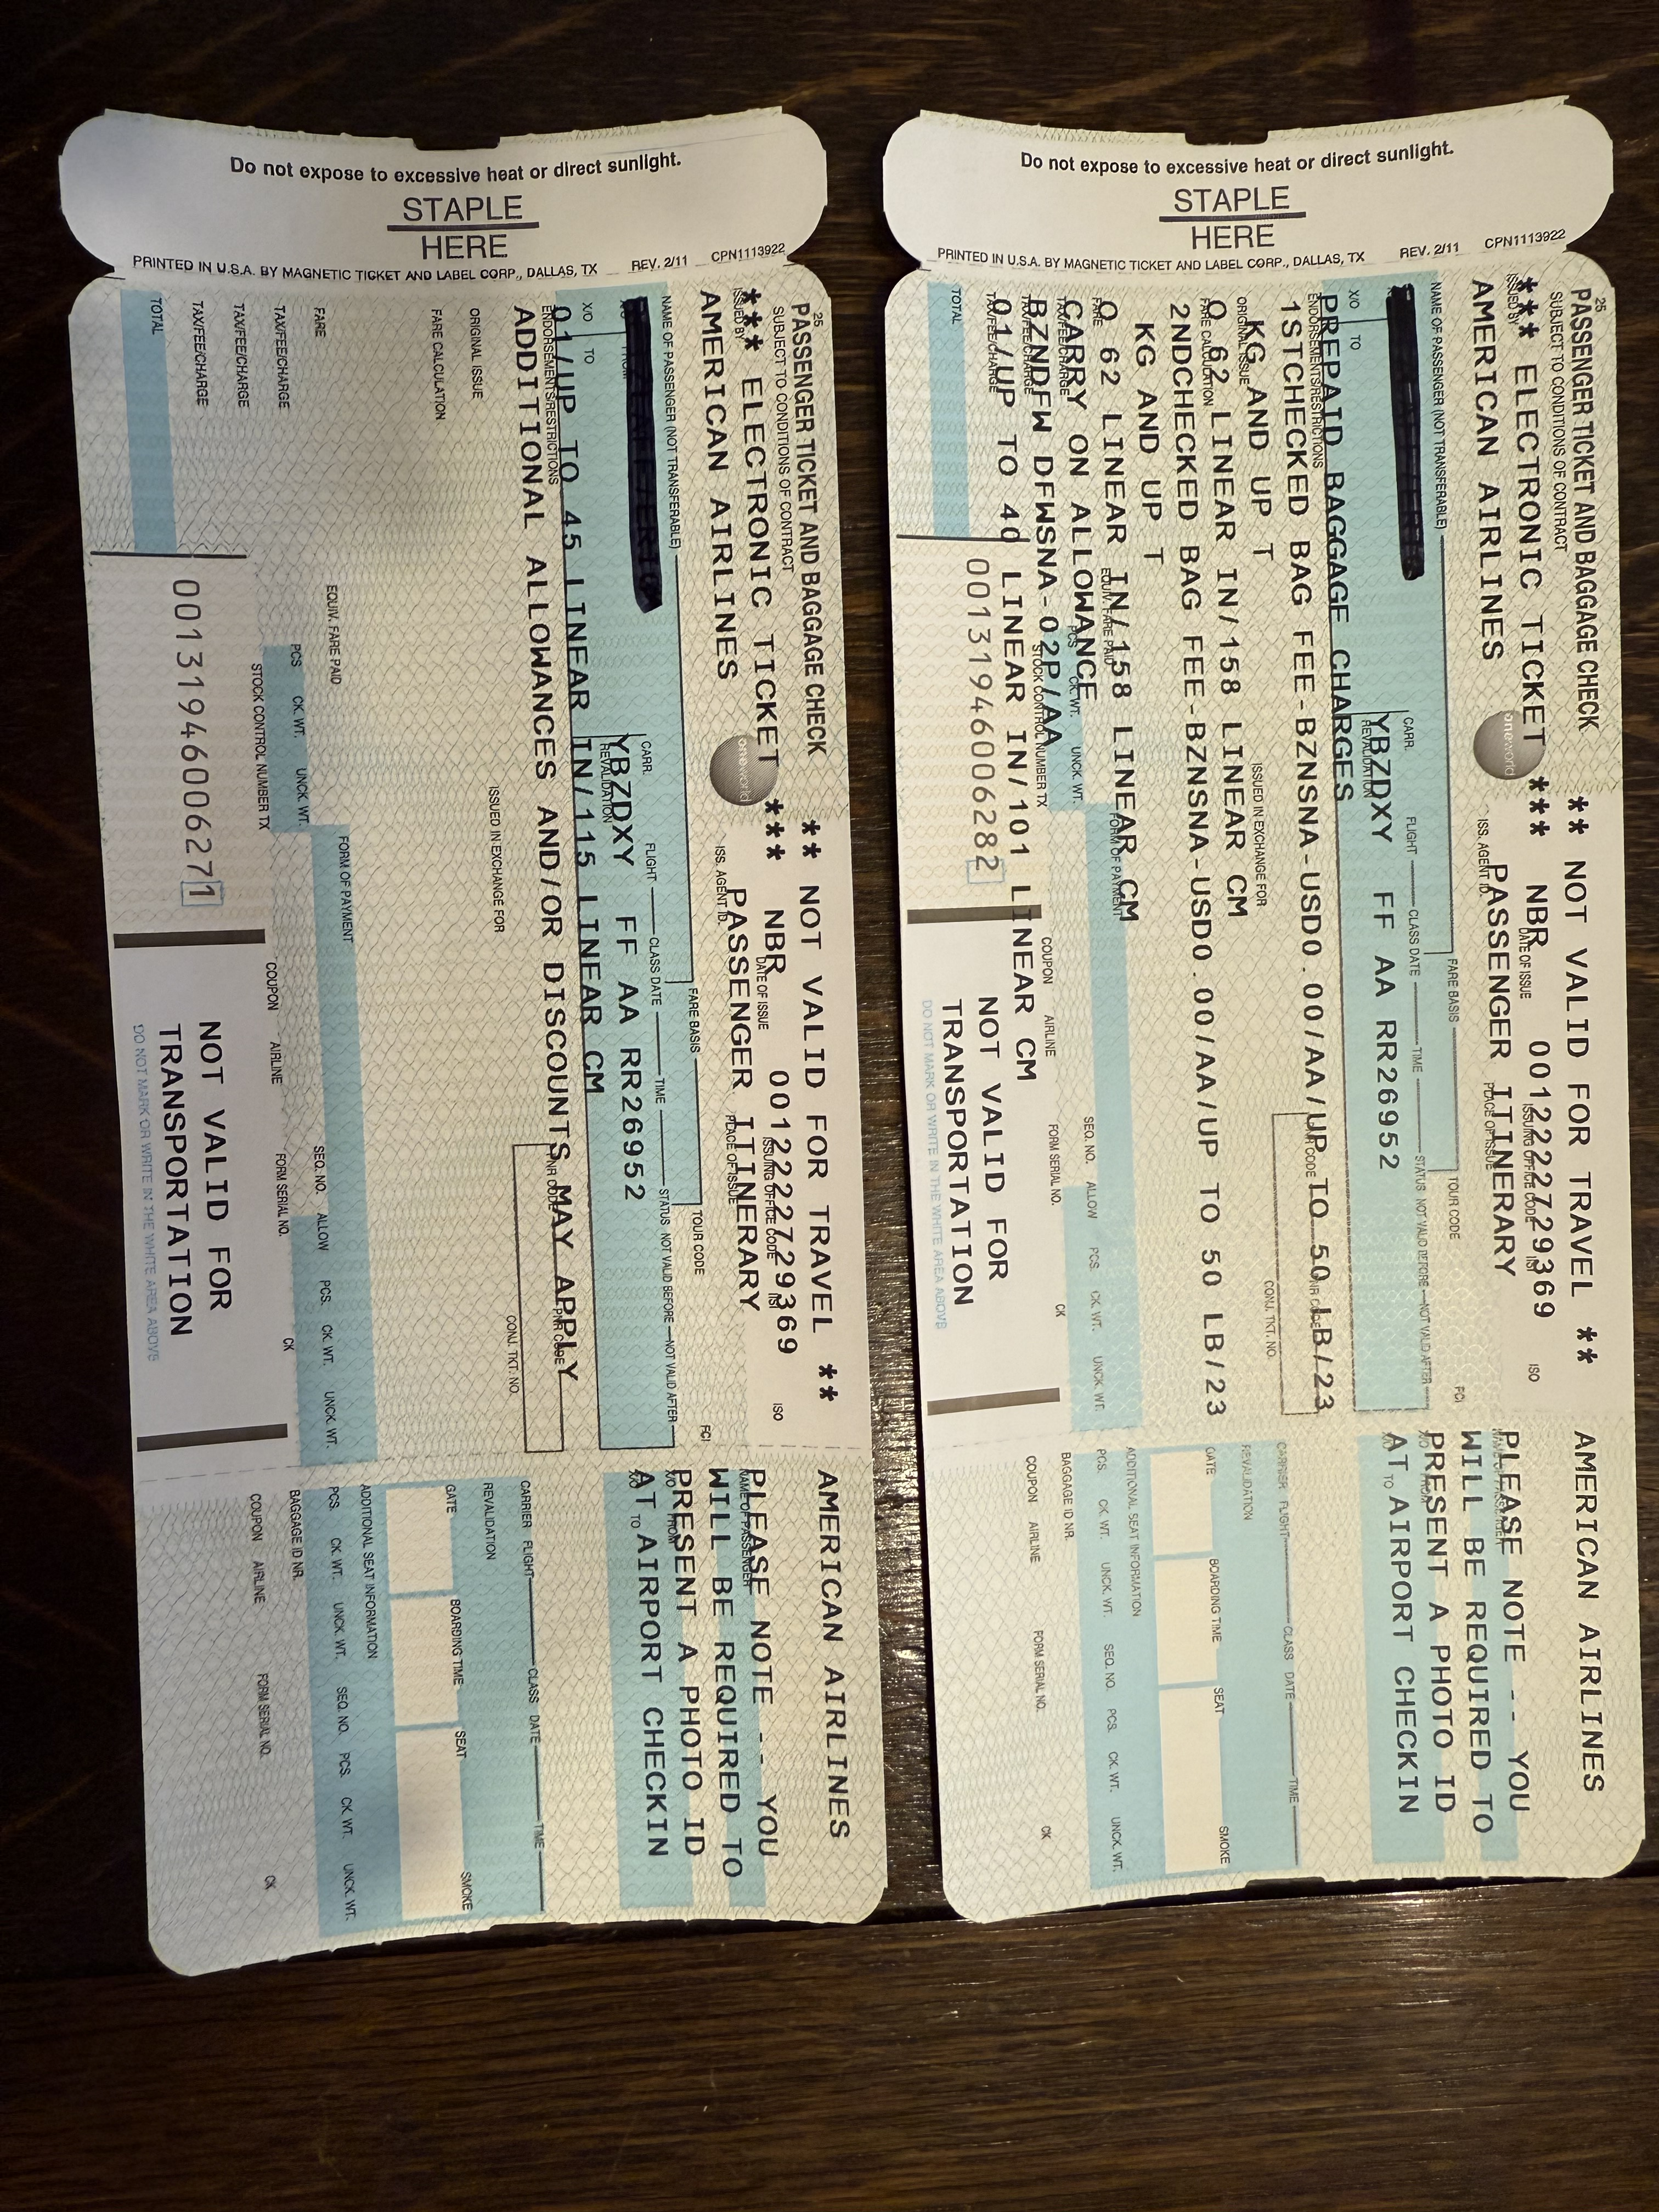
Unneeded Ticket Stock
#1-Itinerary, #2-Fare Info, #3-Boarding Pass

